Slide 1
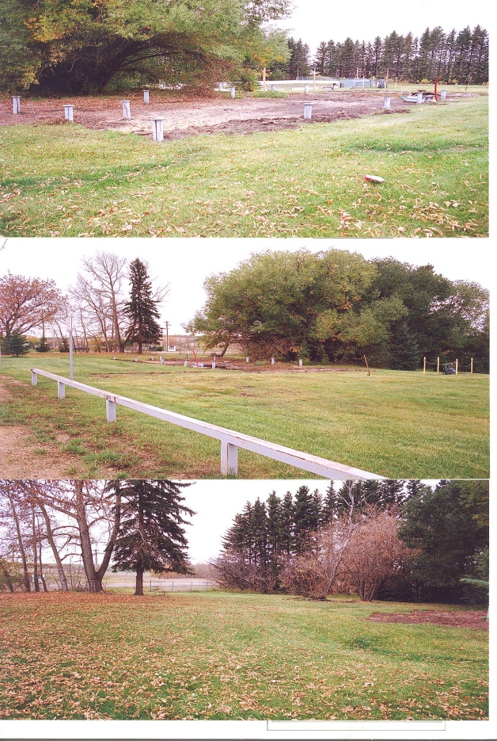
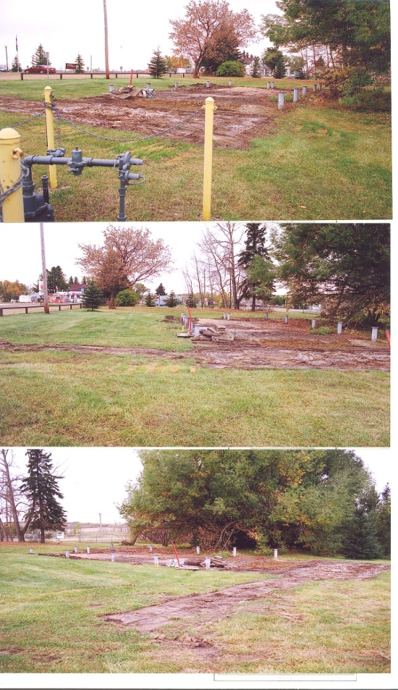
Naturalization Project
Work Continues

Slide 2
Creating the Outdoor Classroom

Slide 3
Outdoor Classroom
Grade ¾ using the outdoor classroom.
Science and Language Arts

Slide 4
Clean Up Day
Grade 5/6 class cleaning up the area getting ready for the dry creek bed.

Slide 5
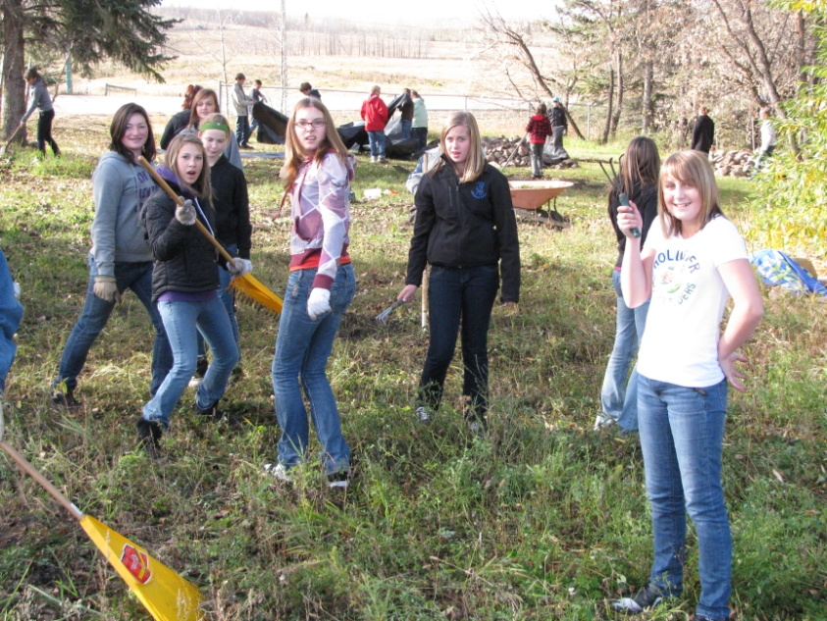
Junior High Students
Students cleaning up the garden area. This area is for the bird and butterfly garden and adjacent to this will be the test gardens.

Slide 6
Dry Creek Bed
Work! Work! Work! Dig! Dig! Dig! These students are working hard digging in the hard ground to create the base of the dry creek bed.

Slide 7
Dry Creek Bed
Loads of rocks to be placed!

Slide 8
Not Quite Finished …..But Soon
Before
After

Slide 9
Everyone Contributes to the Project
Mr. Beechinor’s Grade ½ class
Mr. Tschabold’s Grade ½ class

Slide 10
Feeding the Workers!
They are going to be hungry!
What an assembly line!

Slide 11
One of our community members relaxing after working in the garden.

Slide 12
Spring 2011
Late in the fall of 2010, pathways were cut in ready for the spring.
Now pathways need to be cut down so mulch can be added in May, 2011.
Bridge will be installed on piles and welded on caps in May, 2011.
Park benches will be added in May, 2011.
Bird and butterfly garden prepared and planted in June 2011.
Trial gardens prepared and planted in June 2011.

Slide 13
Maintenance
A maintenance plan will be in place for the summer. Our plan is to plant potatoes and pumpkins . In the fall of 2011, we plan to have a fall festival making as many things as we can using the harvest. Ie. Potato salad, potato soup, pumpkin pie, pumpkin muffins.

Slide 14
Mrs Wheeliker’s Kindergarten’s Class Helping out.
Cargill helps out in donations and labor! Thanks Dan!

Slide 15
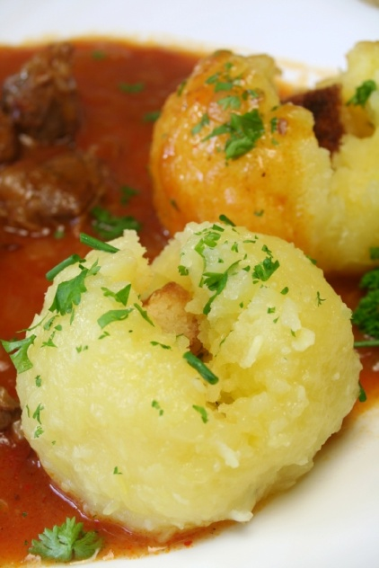
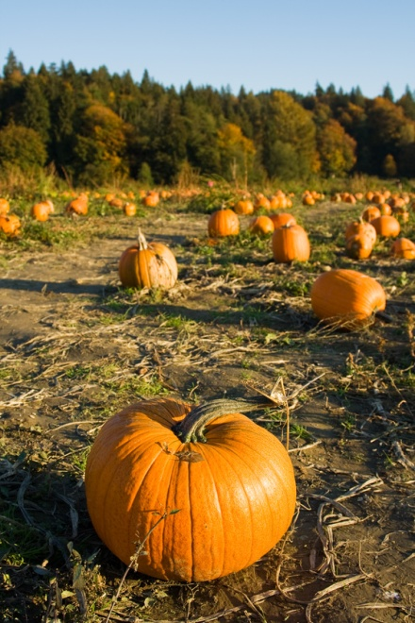
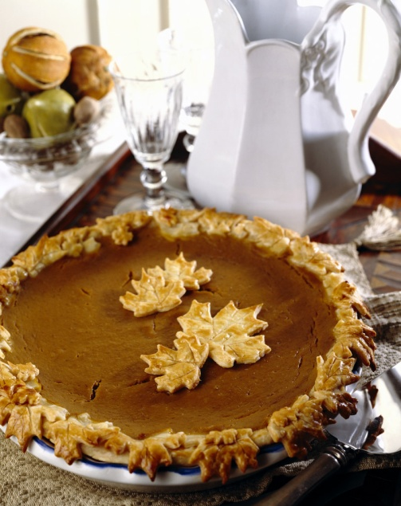
Fall Festival
In the fall of 2011, we plan on using our harvest to make different things such as potato soup, potato salad, pumpkin pie etc.

